Slide 1
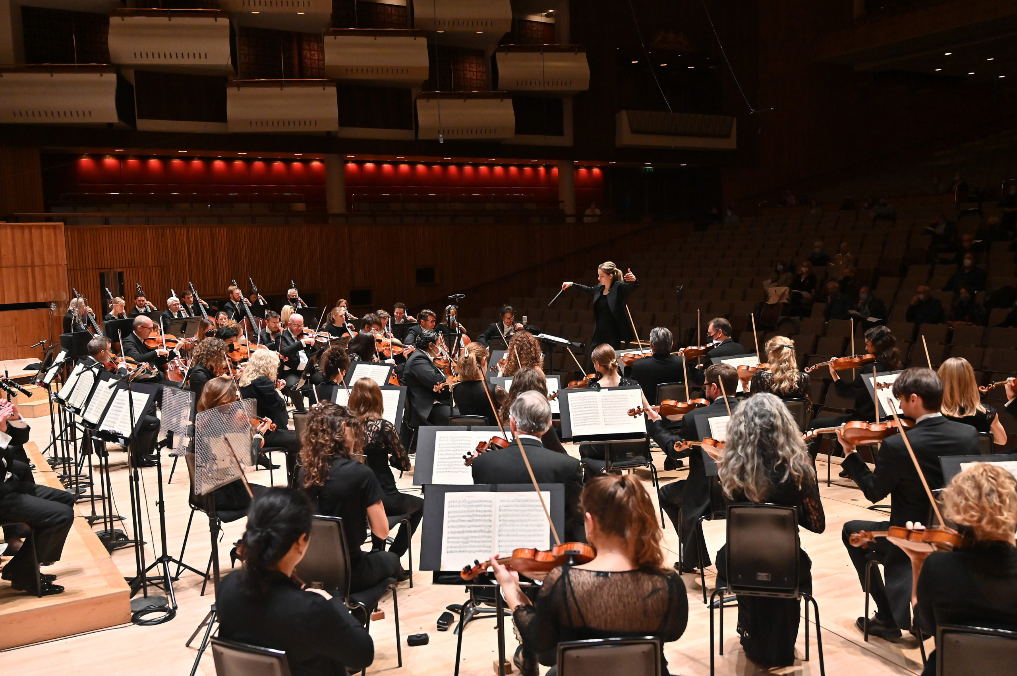
GCSE BrightSparks
Resources
BrightSparks is generously funded by the Rothschild Foundation with additional support from the Candide Trust, Dunard Fund, Rivers Foundation, The R K Charitable Trust, Mr & Mrs Philip Kan, Gill and Julian Simmonds
© Rachel Leach and the London Philharmonic Orchestra 2022

Slide 2
Zoltán Kodály
1882-1967
Háry János
(1926)
‘The Battle and Defeat of Napoleon’
and
‘Intermezzo’

Slide 3
Zoltán Kodály
1882-1967
Hungarian composer
Famous for:
Inventing a system of music education
Saving thousands of folk songs with friend Béla Bártok
Háry János (1926 opera)

Slide 4
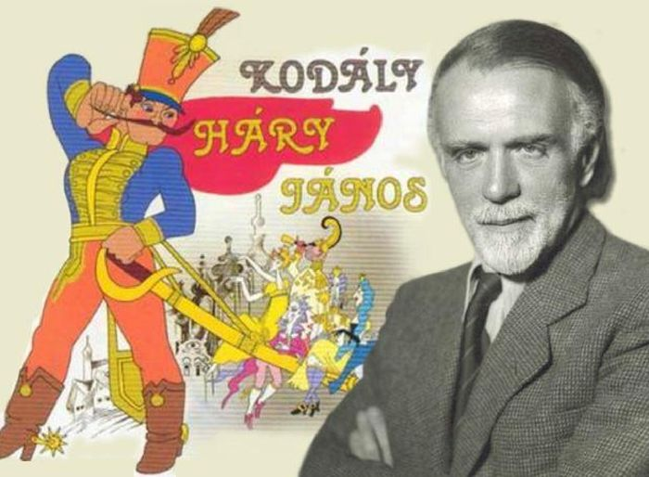
Kodály – Háry János Suite – 1926
Háry János (1926)
Háry János is an opera
Tells the story of a soldier and his adventures
Kodály created a suite
Suite = here means ‘best bits’ for orchestra

Slide 5
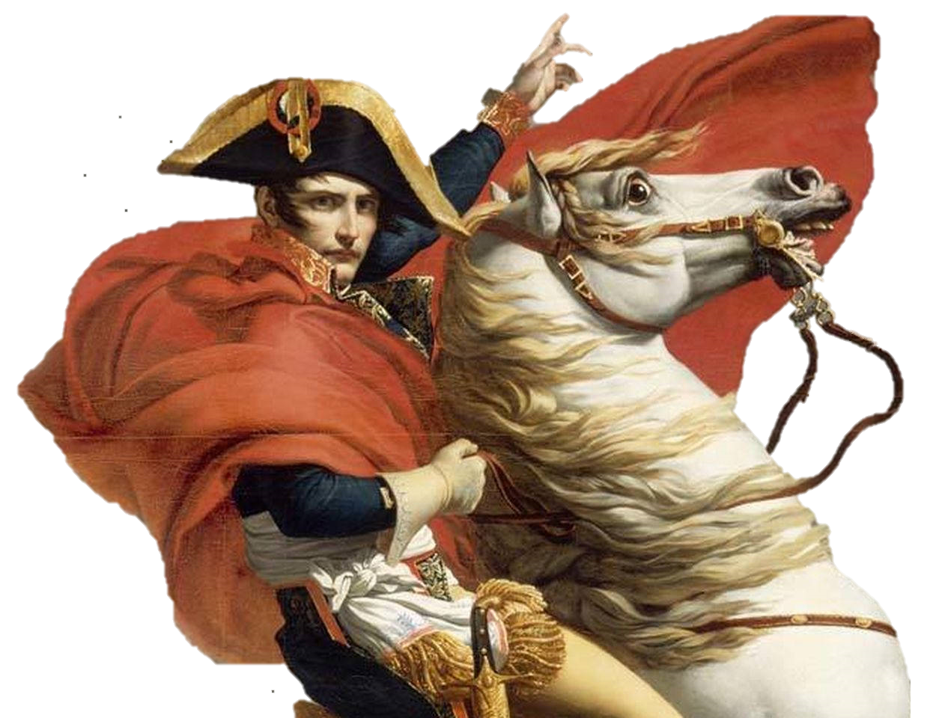
Kodály – The Battle and Defeat of Napoleon – 1926
The Battle and Defeat of Napoleon
Written for:
Woodwind (3 piccolos, alto saxophone)
Brass (3 trumpets, 3 trombones, bass tuba)
Percussion (triangle, bass drum, cymbals, tambourines)
No string section!

Slide 6
Kodály – The Battle and Defeat of Napoleon – 1926
Analysis

Slide 7
Kodály – The Battle and Defeat of Napoleon – 1926
Military Theme
Begins with percussion
Starts p, then crescendo to f
Melody uses dotted rhythms, and is angular (disjunct) and sometimes stepwise (conjunct)
Dorian mode (all white notes D-D)

Slide 8
Kodály – The Battle and Defeat of Napoleon – 1926
Disjunct = features jumps and leaps
Conjunct = moves stepwise

Slide 9
Kodály – The Battle and Defeat of Napoleon – 1926
‘Explosion’
Piccolo tremolando (two notes alternating quickly)
Grace notes on brass (little swoops upward)
Cymbal crash
Descending chromatic scale
Saxophone semitone ‘lean’
Dissonant harmony (clashing, not in a key)

Slide 10
Kodály – The Battle and Defeat of Napoleon – 1926
Fanfare
Trumpets and trombones
Triplet rhythms
2 interesting intervals - major 7th and augmented 4th

Slide 11
Kodály – The Battle and Defeat of Napoleon – 1926
Military Theme, Explosion, Fanfare repeat
‘Footsteps’ added from trombones and third trumpet
More percussion
Woodwind join the military theme at Figure 3
Crescendo tells us the army is approaching
Added instruments and thicker texture indicate that the army is confident
Explosion features trills
Saxophone added to Fanfare

Slide 12
Kodály – The Battle and Defeat of Napoleon – 1926
Repetition = ideas repeat (without change)
Contrast = subsequent ideas are vastly different

Slide 13
Kodály – The Battle and Defeat of Napoleon – 1926
Napoleon Theme
Pesante = heavily
Parody of French National Anthem:
Fanfare figures (triplets, 5ths, triads) interject between phrases

Slide 14
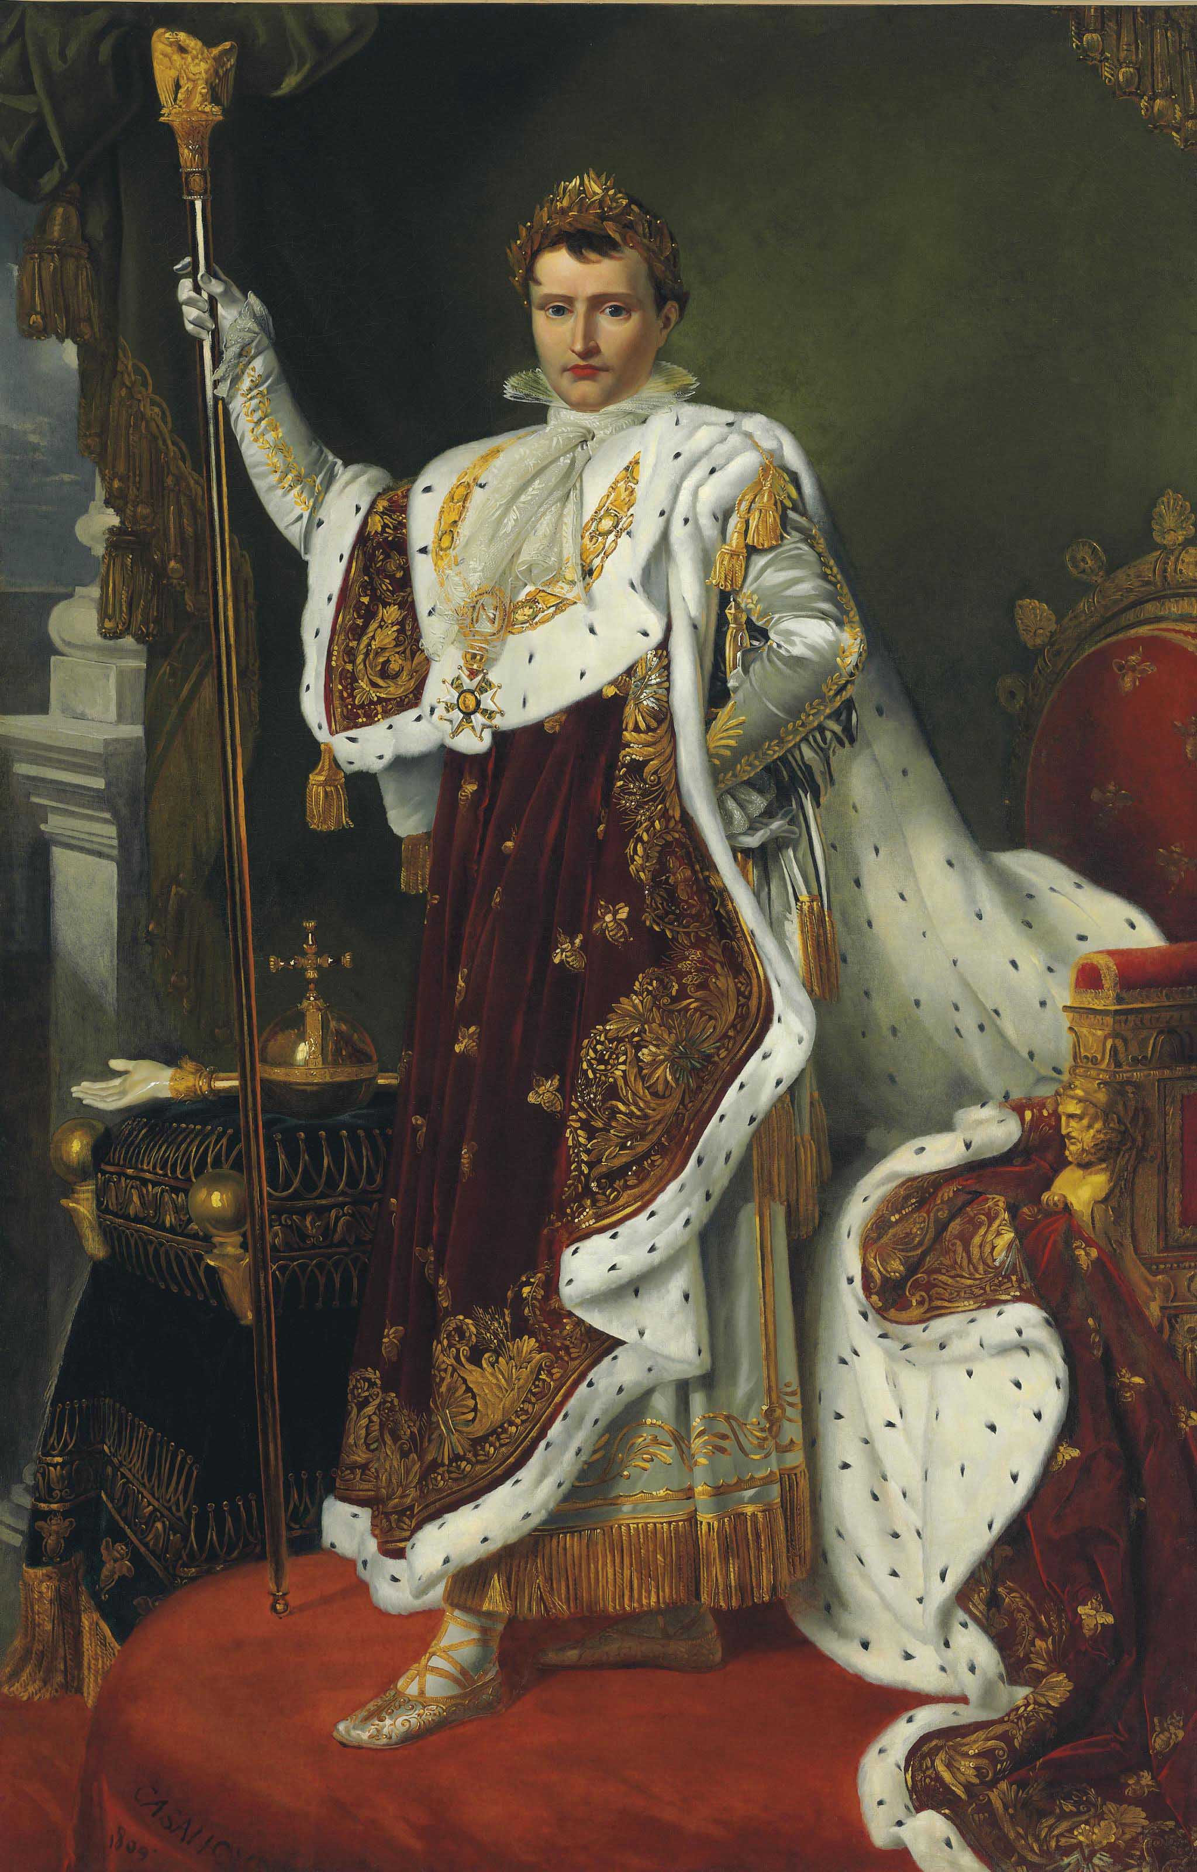
Kodály – The Battle and Defeat of Napoleon – 1926
Napoleon Theme repeats
Bigger and grander
In B major (down a semitone)
Piccolos have long trills
Abrupt stop
Bar of silence (lunga pausa)

Slide 15
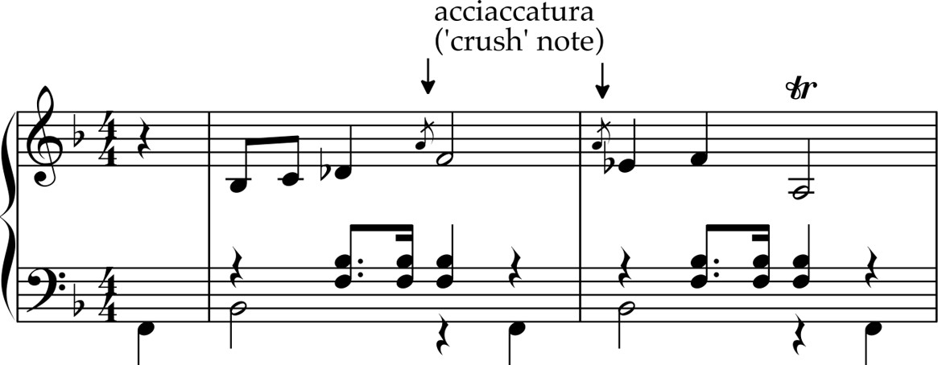
Kodály – The Battle and Defeat of Napoleon – 1926
Funeral March
March-like accompaniment
In B flat minor
Saxophone solo with ornaments (like Hungarian folk music)

Slide 16
Kodály – The Battle and Defeat of Napoleon – 1926
Structure Summary

Slide 17
Kodály – The Battle and Defeat of Napoleon – 1926
Section 1: Build-up to the battle
Introduction
Theme A (military)
Theme A repeats
Figure 1: Explosion
Fanfare
Theme A repeats
Theme A repeats again
Explosion repeats
Fanfare repeats

Slide 18
Kodály – The Battle and Defeat of Napoleon – 1926
Section 2: The Arrival of Napoleon
New section introduced by percussion
Theme B (Napoleon)
Theme B (Napoleon) repeats
Lunga pausa = long silence

Slide 19
Kodály – The Battle and Defeat of Napoleon – 1926
Section 3: The Defeat of Napoleon
Theme C (Funeral March)
Funeral march fades away
Morendo = dying away

Slide 20
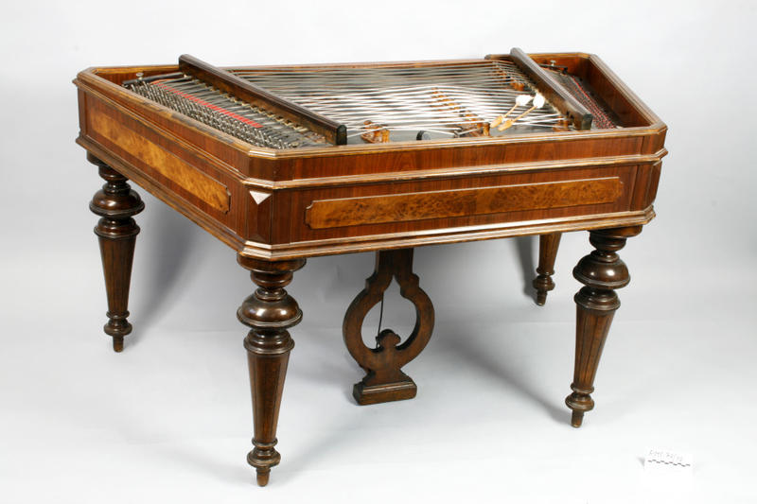
Kodály – Intermezzo – 1926
Intermezzo
A short connecting piece between acts of a play or opera
Cimbalom
A type of string instrument from Hungary
Played with two beaters

Slide 21
Kodály – Intermezzo – 1926
What is a cimbalom?
https://www.youtube.com/watch?v=62x1HkiaWQA

Slide 22
Kodály – Intermezzo – 1926
Analysis

Slide 23
Kodály – Intermezzo – 1926
The piece starts on the upbeat with a short upward flourish made up of three demisemiquavers
Quiz Question: What is it called when the phrase starts on the upbeat?

Slide 24
Kodály – Intermezzo – 1926
Answer: Anacrusis!

Slide 25
Kodály – Intermezzo – 1926
Section A: Main Theme
Played by clarinet and strings
It features a scotch snap rhythm – a semiquaver followed by a dotted quaver
In D major
The cimbalom plays a variation of the melody but using a constant stream of semiquavers

Slide 26
Kodály – Intermezzo – 1926
Quiz Question: The melody moves stepwise. What is this called?

Slide 27
Kodály – Intermezzo – 1926
Answer: Conjunct

Slide 28
Kodály – Intermezzo – 1926
Section A: Main Theme repeats
Flute is added an octave higher
Bassline becomes chromatic which changes the chords and harmonies
Theme ends on dominant chord (A minor)
Main theme (1st and 2nd version) repeat again

Slide 29
Kodály – Intermezzo – 1926
Bar 17: poco pesante = a little heavily
Bar 18: Tempo = speed
Quiz Question: What does it mean when
‘tempo’ is written above the stave?

Slide 30
Kodály – Intermezzo – 1926
Bar 17: poco pesante = a little heavily
Bar 18: Tempo = speed
Answer: Return to the original speed

Slide 31
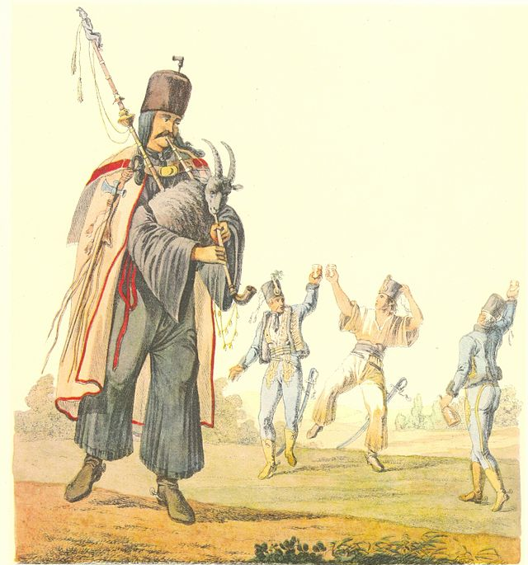
Kodály – Intermezzo – 1926
Section A: Verbunkos
Music slows just for bar 17, in the style of a Verbunkos
Verbunkos = a Hungarian dance performed by two people
Slow bar danced by an important older soldier
Faster music danced by younger soldiers

Slide 32
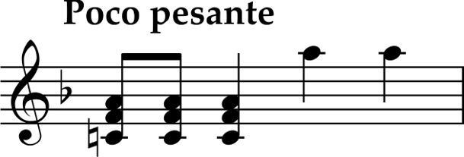
Kodály – Intermezzo – 1926
Quiz Question: This slow bar features a leap. What’s the technical term for this?

Slide 33
Kodály – Intermezzo – 1926
Answer: Disjunct
Melody that follows is conjunct – it moves by step

Slide 34
Kodály – Intermezzo – 1926
The cimbalom decorates the melody
At bar 25 it plays some offbeat chords
Quiz Question: What’s the technical term for music played on the offbeats?

Slide 35
Kodály – Intermezzo – 1926
Answer: Syncopation

Slide 36
Kodály – Intermezzo – 1926
Section A: Verbunkos theme repeats at Figure 1
Fuller orchestra
Trumpets are added to the end of the theme

Slide 37
Kodály – Intermezzo – 1926
After the Verbunkos theme is repeated, we move to a new, contrasting section
Quiz Question: This piece is in ternary form.
What is the structure of ternary form?

Slide 38
Kodály – Intermezzo – 1926
Answer: ABA
We have now arrived at the B (middle) section

Slide 39
Kodály – Intermezzo – 1926
We have now arrived at Section B
Contrasts with Section A
Begins with a solo instrument
Quiz Question: Which solo instrument plays at Figure 2?

Slide 40
Kodály – Intermezzo – 1926
We have now arrived at Section B
Contrasts with Section A
Begins with a solo instrument
Answer: Horn

Slide 41
Kodály – Intermezzo – 1926
Section B
Horn solo accompanied by tonic and dominant harmonies in D major
Lots of ornaments added to the melody
Melody made up of 4-bar phrases – balanced (regular phrasing)
Figure 3: melody moves to clarinet, bassoon, viola and cello
Regular phrasing = phrases of equal length

Slide 42
Kodály – Intermezzo – 1926
Section B
Bar 57 – variation on horn melody
Briefly modulates to B minor, then E minor
This section ends with a clarinet solo
Kodály explores different timbres through different combinations of instruments
Timbre = the character or quality of the sound

Slide 43
Kodály – Intermezzo – 1926
The variation is repeated
At the end, the clarinet solo is taken over by a solo on a different instrument
Quiz Question: Which solo instrument plays at bar 68?

Slide 44
Kodály – Intermezzo – 1926
The variation is repeated
At the end, the clarinet solo is replaced by a solo on a different instrument
Answer: Flute
The phrase ends on a perfect cadence which marks the end of Section B

Slide 45
Kodály – Intermezzo – 1926
Section A repeats
Main theme and Verbunkos theme repeat as before
Piece finishes with a modified perfect cadence:
Features a flattened 9th chord shifting to a regular dominant 7th, finishing with the tonic chord

Slide 46
Kodály – Intermezzo – 1926
Section A
Section B
Section A
Main theme (with anacrusis)
Main theme repeats
Verbunkos theme
Verbunkos theme repeats
New theme (solo horn)
New theme repeats
Variation of new theme (clarinet solo)
Variation repeats (flute solo)
Main theme (with anacrusis)
Main theme repeats
Verbunkos theme
Verbunkos theme repeats
Modified perfect cadence

Slide 47
For more information about concerts, education projects, resources and recordings, visit
lpo.org.uk
BrightSparks is generously funded by the Rothschild Foundation with additional support from the Candide Trust, Dunard Fund, Rivers Foundation, The R K Charitable Trust, Mr & Mrs Philip Kan, Gill and Julian Simmonds
© Rachel Leach and the London Philharmonic Orchestra 2022

